Slide 1


Chapter 3: Campus Network Architecture
CCNP SWITCH V7.1: Implementing Cisco IP Switched Networks

Slide 2
Chapter 3 Objectives
Implementing VLANs and trunks in a campus switched architecture
Understanding the concept of VTP and its limitation and configurations
Implementing and configuring EtherChannel
2

Slide 3

Implementing VLANs and Trunks in Campus Environment

Slide 4
Implementing VLANs and Trunks in Campus Environment
A VLAN is a logical broadcast domain that can span multiple physical LAN segments.
VLANs provide segmentation and organizational flexibility.
VLANs help administrators to have the end node or workstations group that are segmented logically by functions, project teams, and applications, without regard to the physical location of the users.
VLANs allow you to implement access and security policies to particular groups of users and limit the broadcast domain.
The voice VLAN feature enables access ports to carry IP voice traffic from an IP phone. Because the sound quality of an IP phone call can deteriorate if the data is unevenly sent, the switch supports quality of service (QoS).

Slide 5
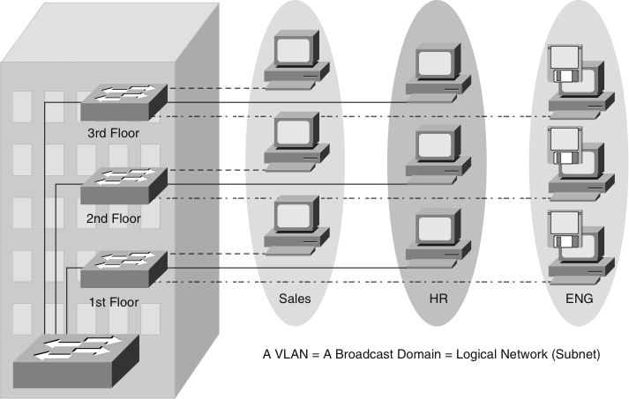
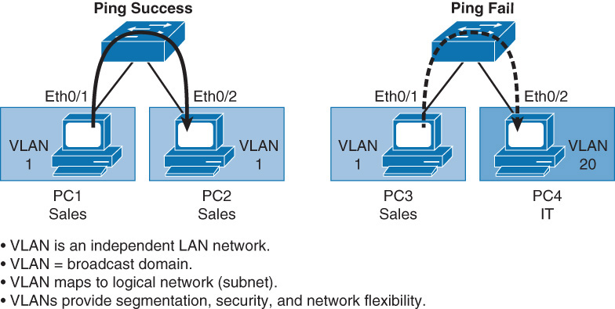
Virtual Local Area Network (VLAN)
A VLAN is a logical group of end devices.
Broadcasts are contained within VLANs.
Ports in the same VLAN share Broadcasts
Modern design has 1 VLAN = 1 IP subnet.
Trunks connect switches so as to transport multiple VLANs.
Layer 3 devices interconnect VLANs.

Slide 6
VLAN Segmentation
Larger flat networks generally consist of many end devices in which broadcasts and unknown unicast packets are flooded on all ports in the network.
One advantage of using VLANs is the capability to segment the Layer 2 broadcast domain.
All devices in a VLAN are members of the same broadcast domain. If an end device transmits a Layer 2 broadcast, all other members of the VLAN receive the broadcast.
Switches filter the broadcast from all the ports or devices that are not part of the same VLAN.
In a campus design, a network administrator can design a campus network with one of two models:
End-to-End VLANs
Local VLANs.
Each model has its own advantages and disadvantages.

Slide 7
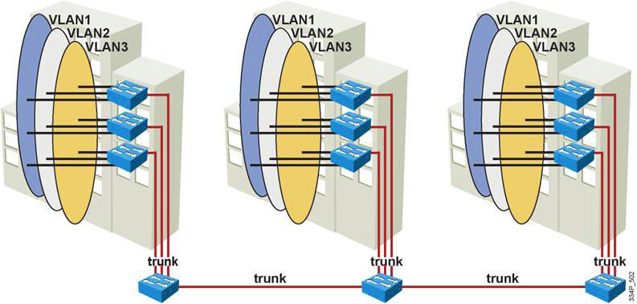
End-to-End VLANs
End-to-End VLAN refers to a single VLAN that is associated with switch ports widely dispersed throughout an enterprise network on multiple switches.

Slide 8
End-to-End VLAN Characteristics
Each VLAN is distributed geographically throughout the network.
Users are grouped into each VLAN regardless of the physical location, theoretically easing network management.
As a user moves throughout a campus, the VLAN membership for that user remains the same, regardless of the physical switch to which this user attaches.
Users are typically associated with a given VLAN for network management reasons. This is why they are kept in the same VLAN, therefore the same group, as they move through the campus
All devices on a given VLAN typically have addresses on the same IP subnet.
Switches commonly operate in a sever/client VTP mode.

Slide 9
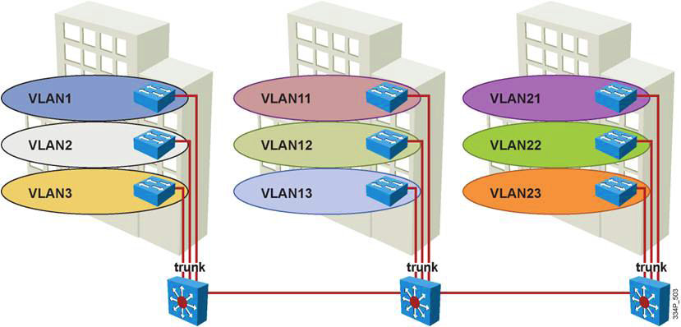
Local VLANs
In a local VLAN model, all users of a set of geographically common switches are grouped into a single VLAN, regardless of the organizational function of those users.
routed
routed
Notes:
The term end-to-end VLAN refers to a single VLAN that is associated with switch ports widely dispersed throughout an enterprise network on multiple switches. A Layer 2 switched campus network carries traffic for each VLAN throughout the network, as shown in the figure, where VLANs 1, 2 and 3 are spread across the campus network.
If more than one VLAN in a network is operating in the end-to-end mode, special links (Layer 2 trunks) are required between switches to carry the traffic of all the different VLANs.

Slide 10
Local VLANs Characteristics and User Guidelines
Create local VLANs with physical boundaries in mind rather than job functions of the users on the end devices.
Local VLANs exist between the access and distribution layers.
Traffic from a local VLAN is routed at the distribution and core levels to reach destinations on other networks
Switches are configured in VTP transparent mode, because VLANs on a given access switch should not be advertised to all other switches in the network, nor do they need to be manually created in any other switch VLAN databases
Spanning tree is used only to prevent inadvertent loops in the wiring closet.
One to three VLANs per access layer switch recommended.
Notes:
The Campus Enterprise Architecture is based on the local VLAN model wherein users of geographically common switches are grouped into a single VLAN, regardless of the organizational function of the users.
Local VLANs are generally confined to a wiring closet, as shown in the figure, and VLANs are local to one access switch which trunks to the distribution switch.
If users move from one location to another in the campus, their connection changes to the new VLAN at the new physical location.
In the local VLAN model, Layer 2 switching is implemented at the access level and routing is implemented at the distribution and core level, as shown in the figure, to enable users to maintain access to the resources they need.

Slide 11
Comparison of End-to-End VLANs and Local VLANs
Reasons for implementing the end-to-end design:
Grouping users
Users can be grouped on a common IP segment, even though they are geographically dispersed.
Security
A VLAN can contain resources that should not be accessible to all users on the network, or there might be a reason to confine certain traffic to a particular VLAN.
Applying quality of service (QoS)
Traffic can be a higher- or lower-access priority to network resources from a given VLAN.

Slide 12
Comparison of End-to-End VLANs and Local VLANs
Reasons for implementing the end-to-end design (cont.):
Routing avoidance
If much of the VLAN user traffic is destined for devices on that same VLAN.
Special-purpose VLAN
Sometimes a VLAN is provisioned to carry a single type of traffic that must be dispersed throughout the campus (for example, multicast, voice, or visitor VLANs).
Poor design
For no clear purpose, users are placed in VLANs that span the campus or even span WANs. Sometimes when a network is already configured and running, organizations are hesitant to improve the design because of downtime or other political reasons.

Slide 13
Comparison of End-to-End VLANs and Local VLANs
End-to-End VLANs drawbacks:
Switch ports are provisioned for each user and associated with a given VLAN. Because users on an end-to-end VLAN can be anywhere in the network, all switches must be aware of that VLAN.
This means that all switches carrying traffic for end-to-end VLANs are required to have those specific VLANs defined in each switch’s VLAN database.
Flooded traffic for the VLAN is, by default, passed to every switch even if it does not currently have any active ports in the particular end-to-end VLAN.
Troubleshooting devices on a campus with end-to-end VLANs can be challenging because the traffic for a single VLAN can traverse multiple switches in a large area of the campus, and that can easily cause potential spanning-tree problems.

Slide 14
Benefits of Local VLANs
Deterministic traffic flow: The simple layout provides a predictable Layer 2 and Layer 3 traffic path
Active redundant paths: When implementing Per VLAN Spanning Tree (PVST) or Multiple Spanning Tree Protocol (MSTP) because there is no loop, all links can be used to make use of the redundant paths.
High availability: Local VLAN traffic on access switches can be passed to the building distribution switches across an alternative Layer 2 path if a primary path failure occurs. Router redundancy protocols can provide failover if the default gateway for the access VLAN fails.
Finite failure domain: If VLANs are local to a switch block, and the number of devices on each VLAN is kept small, failures at Layer 2 are confined to a small subset of users.
Scalable design: Following the enterprise campus architecture design, new access switches can be easily incorporated, and new sub-modules can be added when necessary.
Notes:
Benefits of Local VLANs:
Deterministic traffic flow: The simple layout provides a predictable Layer 2 and Layer 3 traffic path. If a failure occurs that was not mitigated by the redundancy features, the simplicity of the model facilitates expedient problem isolation and resolu­tion within the switch block.
Active redundant paths: When implementing Per VLAN Spanning Tree (PVST) or Multiple Spanning Tree Protocol (MSTP) because there is no loop, all links can be used to make use of the redundant paths.
High availability: Redundant paths exist at all infrastructure levels. Local VLAN traffic on access switches can be passed to the building distribution switches across an alternative Layer 2 path if a primary path failure occurs. Router redundancy protocols can provide failover if the default gateway for the access VLAN fails. When both the Spanning Tree Protocol (STP) instance and VLAN are confined to a specific access and distribution block, Layer 2 and Layer 3 redundancy measures and protocols can be configured to failover in a coordinated manner.
Finite failure domain: If VLANs are local to a switch block, and the number of devices on each VLAN is kept small, failures at Layer 2 are confined to a small subset of users.
Scalable design: Following the enterprise campus architecture design, new access switches can be easily incorporated, and new submodules can be added when necessary.

Slide 15
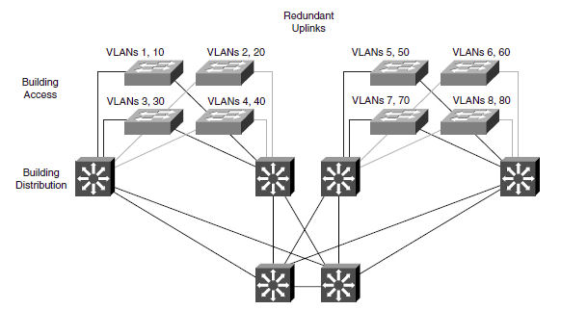
VLANs in Enterprise Campus Design
VLANs used at the access layer should extend no further than their associated distribution switch.
Traffic is routed from the local VLAN as it is passed from the distribution layer into the core.
Blocks can contain one to three VLANs each.
STP is limited to access and distribution switches.
DHCP is used to assign IP addresses to users.

Slide 16
VLAN Support on Catalyst Switches
Catalyst Switch | Max VLANs | VLAN ID Range
2940 | 4 | 1 - 1005
2950/2955 | 250 | 1 - 4094
2960 | 255 | 1 - 4094
2970/3550/3560/3750 | 1055 | 1 - 4094
2848G/2980G/4000/4500 | 4094 | 1 - 4094
6500 | 4094 | 1 - 4094
Notes:
Each Cisco Catalyst switch supports a different number of VLANs, with high-end Cisco Catalyst switches supporting as many as 4096 VLANs.

Slide 17
VLAN Ranges on Catalyst Switches
VLAN Range | Range | Usage | Popagated via VTP?
0, 4095 | Reserved | For system use only. You cannot see or use these. | n/a
1 | Normal | Cisco default. You can use this VLAN, but you cannot delete it. | Yes
2 – 1001 | Normal | For Ethernet VLANs. You can create, use, and delete these. | Yes
1002 – 1005 | Normal | Cisco defaults for FDDI and Token Ring. You cannot delete these. | Yes
1006 – 1024 | Reserved | For system use only. You cannot see or use these. | n/a
1025 - 4094 | Reserved | For Ethernet VLANs only. | VTP v 3 only. Not supported in VTP v1 or v2. Requires VTP transparent mode for configuration.
Notes:
Cisco Catalyst switches support up to 4096 VLANs depending on the platform and software version.
The Catalyst 2950 and 2955 support as many as 64 VLANs with the Standard Software image and up to 250 VLANs with the Enhanced Software image.
Cisco Catalyst switches do not support VLANs 1002 through 1005; these are reserved for Token Ring and FDDI VLANs.
Catalyst 4500 and 6500 families of switches do not support VLANs 1006 through 1024.
Several families of switches support more VLANs than the number of spanning-tree instances. For example, the Cisco Catalyst 2970 supports 1005 VLANs but only 128 spanning-tree instances. For information on the number of supported spanning-tree instances, refer to the Cisco Product Technical Documentation

Slide 18
VLAN Types
A data VLAN is a VLAN that is configured to carry only user-generated traffic.
The default VLAN is the VLAN that all the ports on a switch are members of when a switch is reset to factory defaults. The default VLAN for Cisco switches is VLAN 1. VLAN 1 has all the features of any VLAN, except that you cannot rename it and you cannot delete it. Layer 2 control traffic, such as CDP and Spanning Tree Protocol traffic, will always be associated with VLAN 1—this cannot be changed. It is a security best practice to restrict VLAN 1 to serve as a conduit only for Layer 2 control traffic, supporting no other traffic.
A native VLAN is assigned to an 802.1Q trunk port. An IEEE 802.1Q trunk port supports traffic coming from many VLANs (tagged traffic) as well as traffic that does not come from a VLAN (untagged traffic).
A management VLAN is a VLAN defined by the switch administrator as a means to accessing the management capabilities of a switch.
A voice VLAN is a dedicated VLAN for Voice over IP traffic and associated signaling traffic.
Notes:
VLAN Types (from CCNA). Among the (port-based) VLANs are a number of types of VLANs. Some VLAN types are defined by the type of traffic they support; others are defined by the specific functions they perform. The principal VLAN types are data VLANs, the default VLAN, the black hole VLAN, native VLANs, management VLANs, and voice VLANs. Because switches will be carrying traffic associated with several VLANs, ports connecting to other switches are used to carry traffic for more than one VLAN; these are called trunk ports (coming soon).
A data VLAN is a VLAN that is configured to carry only user-generated traffic. Typically, multiple data VLANs populate a switched infrastructure. A VLAN could carry voice-based traffic or traffic used to manage the switch, but this traffic would not be part of a data VLAN. It is common practice to separate voice and management traffic from data traffic. The importance of separating user data from switch management control data and voice traffic is highlighted by the use of a special term used to identify VLANs that carry only user data—a data VLAN. A data VLAN is sometimes called a user VLAN.
The default VLAN is the VLAN that all the ports on a switch are members of when a switch is reset to factory defaults. All switch ports are members of the default VLAN after the initial boot of the switch. If all the switch ports are members of the default VLAN, they are all part of the same broadcast domain; this allows any device connected to any switch port to communicate with any device on any other switch port. The default VLAN for Cisco switches is VLAN 1. VLAN 1 has all the features of any VLAN, except that you cannot rename it and you cannot delete it. Layer 2 control traffic, such as CDP and Spanning Tree Protocol traffic, will always be associated with VLAN 1—this cannot be changed. It is a security best practice to restrict VLAN 1 to serve as a conduit only for Layer 2 control traffic, supporting no other traffic.
Some network engineers use the term default VLAN to mean a VLAN other than VLAN 1 defined by the network engineer as the VLAN that all ports are assigned to when they are not in use. We use the term black hole VLAN to distinguish this VLAN from the default VLAN. The default VLAN is intrinsic to the switch out-of-the-box; it is VLAN 1 on Cisco switches. The black hole VLAN is defined by the switch administrator. It is a security best practice to define a black hole VLAN to be a dummy VLAN distinct from all other VLANs defined in the switched LAN. All unused switch ports are assigned to the black hole VLAN so that any device connecting to an unused switch port will be assigned to the black hole VLAN. Any traffic associated with the black hole VLAN is not allowed on trunk links, thus preventing any device associated with the black hole VLAN from communicating beyond the switch to which it is connected.
A native VLAN (introduced later) is assigned to an 802.1Q trunk port. An IEEE 802.1Q trunk port supports traffic coming from many VLANs (tagged traffic) as well as traffic that does not come from a VLAN (untagged traffic). The 802.1Q trunk port places untagged traffic on the native VLAN. Native VLANs are set out in the IEEE 802.1Q specification to maintain backward compatibility with untagged traffic common to legacy LAN scenarios. For our purposes, a native VLAN serves as a common identifier on opposing ends of a trunk link. It is a security best practice to define a native VLAN to be a dummy VLAN distinct from all other VLANs defined in the switched LAN. The native VLAN is not used for any traffic in the switched network unless legacy bridging devices happen to be present in the network, or a multiaccess interconnection exists between switches joined by a hub (not likely in a modern network).
A management VLAN is a VLAN defined by the switch administrator as a means to accessing the management capabilities of a switch. VLAN 1 would serve as the management VLAN if you did not proactively define a unique VLAN to serve as the management VLAN. You assign the management VLAN an IP address and subnet mask. A switch can be managed via HTTP, Telnet, SSH, or SNMP. Because the out-of-the-box configuration of a Catalyst switch has VLAN 1 as the default VLAN, you see that VLAN 1 or the black hole VLAN would be a bad choice as the management VLAN; you wouldn’t want an arbitrary user connecting to a switch to default to the management VLAN. It is a security best practice to define the management VLAN to be a VLAN distinct from all other VLANs defined in the switched LAN.
A voice VLAN is a dedicated VLAN for Voice over IP traffic and associated signaling traffic. Typically in an enterprise campus network, a PC connects to an IP phone which in turn connects to an access layer switch port configured with a data VLAN and a voice VLAN (it is a sort of trunk port carrying only 2 VLANs). A Cisco switch can use CDP to communicate with a Cisco IP phone to help optimize the configuration of the switch and IP phone for QoS support of the simultaneous data and voice traffic over the link. Voice traffic is tagged with the voice VLAN and data traffic is tagged with the data VLAN for the attached PC (note this scenario also can work with a PC running a softphone).

Slide 19
Configuration: Create a VLAN
To create a new VLAN in global configuration mode.
Switch(config)# vlan vlan-id
vlan-id is 2-1001 or 1025-4094
Notes:
See previous slide for VLAN ID information.

Slide 20
Configuration: Name a VLAN
To name a VLAN in VLAN configuration mode.
Switch(config-vlan)# name vlan-name
vlan-name is a descriptor for the VLAN.
Naming a VLAN is optional.

Slide 21
Example: Creating and Naming a VLAN
Enter global configuration mode:
Switch# configure terminal
Create a new VLAN with a particular ID number:
Switch(config)# vlan vlan-id
(Optional.) Name the VLAN:
Switch(config-vlan)# name vlan-name
Switch# configure terminal
Switch(config)# vlan 5
Switch(config-vlan)# name Engineering
Switch(config-vlan)# exit
Notes:
To delete a VLAN in global configuration mode, follow these steps:
Step 1. Enter global configuration mode:
Switch# configure terminal
Step 2. Delete the VLAN by referencing its ID number:
Switch(config)# no vlan vlan-id
Note: After a VLAN is deleted, the access ports that belong to that VLAN move into the inactive state until the ports are moved to another VLAN. As a security measure, ports in the inactive state do not forward traffic.

Slide 22
Configuration: Disable Trunk Negotiation on a Port
To disable trunk negotiation on a switch port.
Switch(config-if)# switchport mode access
This command is optional but is recommended for security purposes. An access port does not need to negotiate trunk formation.

Slide 23
Configuration: Macro for Access Port
To configure an optional macro for switch access ports.
Switch(config-if)# switchport host
This command optimizes a Layer 2 port for a host connection.
This macro:
sets the port mode to access,
enables spanning-tree portfast,
and disables EtherChannel.

Slide 24
Configuration: Assign Port to VLAN
To assign a port to a VLAN in interface configuration mode.
Switch(config-if)# switchport access vlan vlan-id
vlan-id is a previously created VLAN.
Notes:
Semantics: a port is assigned to a VLAN – a VLAN is not assigned to a port.

Slide 25
Example: Assigning a Port to a VLAN
Enter interface configuration mode:
Switch(config)# interface interface-id
Configure a description for the device(s) connected to the port:
Switch(config-if)# description string
Configure access port macro:
Switch(config-if)# switchport host
Assign port to VLAN:
Switch(config-if)# switchport access vlan vlan-id
Enable the interface:
Switch(config-if)# no shutdown
Return to Privileged EXEC mode
Switch(config-if)# end
Switch(config)# interface FastEthernet 5/6
Switch(config-if)# description PC A
Switch(config-if)# switchport host
switchport mode will be set to access
spanning-tree portfast will be enabled
channel group will be disabled
Switch(config-if)# switchport access vlan 200
Switch(config-if)# no shutdown
Switch(config-if)# end
Notes:
Use the switchport command with no keywords to configure interfaces as Layer 2 interfaces on Layer 3 switches. After configuring the interface as a Layer 2 interface, use additional switchport commands with keywords to configure Layer 2 properties such as access VLANs or trunking.

Slide 26
Verification: VLAN Configuration
The show vlan command and its derivatives are the most useful commands for displaying information related to VLANs. The following two forms have the same output.
Switch# show vlan id 3
VLAN Name Status Ports
---- -------------------------------- --------- -------------------------------
3 VLAN0003 active Fa0/1
VLAN Type SAID MTU Parent RingNo BridgeNo Stp BrdgMode Trans1 Trans2
---- ----- ---------- ----- ------ ------ -------- ---- -------- ------ ------
3 enet 100003 1500 - - - - - 0 0
Switch# show vlan name VLAN0003
VLAN Name Status Ports
---- -------------------------------- --------- ---------------------
3 VLAN0003 active Fa0/1
VLAN Type SAID MTU Parent RingNo BridgeNo Stp BrdgMode Trans1 Trans2
---- ----- ---------- ----- ------ ------ -------- ---- -------- ------ ------
3 enet 100003 1500 - - - - - 0 0

Slide 27
Verification: Interface Configuration
The show running-config command has an interface keyword option to allow for interface-specific output.
Switch# show running-config interface FastEthernet 5/6
Building configuration...
!
Current configuration :33 bytes
interface FastEthernet 5/6
switchport access vlan 200
switchport mode access
switchport host
end

Slide 28
Verification: Switch Port Configuration
One of the most useful commands for showing VLAN configuration information specific to a switch port is the show interfaces interface_id switchport command.
Switch# show interfaces f0/18 switchport
Name: Fa0/18
Switchport: Enabled
Administrative Mode: static access
Operational Mode: down
Administrative Trunking Encapsulation: dot1q
Negotiation of Trunking: Off
Access Mode VLAN: 20 (VLAN0020)
Trunking Native Mode VLAN: 1 (default)
Administrative Native VLAN tagging: enabled
Voice VLAN: 150 (VLAN0150)
<output omitted>
Operational private-vlan: none
Trunking VLANs Enabled: ALL
Pruning VLANs Enabled: 2-1001
Capture Mode Disabled
Capture VLANs Allowed: ALL

Slide 29
Verification: MAC Address Information
You can view MAC address information specific to an interface and an associated VLAN.
Switch# show mac-address-table interface GigabitEthernet 0/1 vlan 1
Mac Address Table
------------------------------------------
Vlan Mac Address Type Ports
---- ----------- ---- -----
1 0008.2199.2bc1 DYNAMIC Gi0/1
Total Mac Addresses for this criterion: 1

Slide 30
Questions
1. How does implementing VLANs help improve the overall performance of the network?
a. By isolating problem employees
b. By constraining broadcast traffic
c. By grouping switch ports into logical communities
d. By forcing the Layer 3 routing process to occur between VLANs
2. What are the advantages of using local VLANs over end-to-end VLANs? (Choose two.)
a. Eases management
b. Eliminates the need for Layer 3 devices
c. Allows for a more deterministic network
d. Groups users by logical commonality
e. Keeps users and resources on the same VLAN

Slide 31
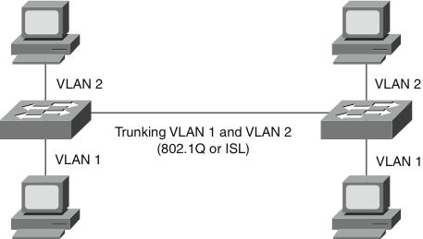
VLAN Trunking
Trunks carry the traffic for multiple VLANs across a single physical link (multiplexing). Trunking is used to extend Layer 2 operations across an entire network.
The host on the left in VLAN 2 can communicate with the host on the right in VLAN 2 via the trunk link; over the same trunk link, the hosts on VLAN 1 can communicate simultaneously.

Slide 32
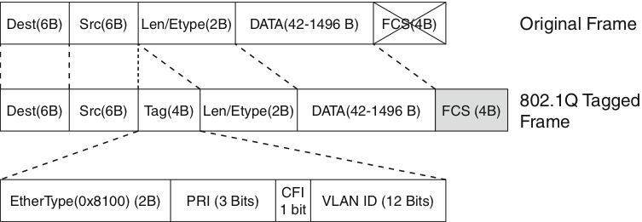
VLAN Trunking with IEEE 802.1Q
802.1Q is a widely supported industry-standard protocol.
IEEE 802.1Q has smaller frame overhead than ISL. 802.1Q overhead is 4 bytes.
802.1Q is a widely supported industry standard protocol.
802.1Q has the 802.1p field for QoS support.
Notes:
Dest: Destination MAC address (6 bytes)
Src: Source MAC address (6 bytes)
Tag: Inserted 802.1Q tag (4 bytes, detailed here):
EtherType(TPID): Set to 0x8100 to specify that the 802.1Q tag follows.
PRI: 3-bit 802.1p priority field.
CFI: Canonical Format Identifier; is always set to 0 for Ethernet switches and to 1 for Token Ring-type networks.
VLAN ID: 12-bit VLAN field. Of the 4096 possible VLAN IDs, the maximum number of possible VLAN configurations is 4094. A VLAN ID of 0 indicates priority frames, and value 4095 (FFF) is reserved. CFI, PRI, and VLAN ID are represented as Tag Control information (TCI) fields.
Len/Etype: 2-byte field specifying length (802.3) or type (Ethernet II).
Data: Data itself.
FCS: Frame check sequence (4 bytes).

Slide 33
802.1Q tag
Inserted 802.1Q tag (4 bytes, detailed here)
EtherType(TPID): Set to 0x8100 to specify that the 802.1Q tag follows.
PRI: 3-bit 802.1p priority field.
CFI: Canonical Format Identifier is always set to 0 for Ethernet switches and to 1 for Token Ring-type networks.
VLAN ID: 12-bit VLAN field. Of the 4096 possible VLAN IDs, the maximum number of possible VLAN configurations is 4094. A VLAN ID of 0 indicates priority frames, and value 4095 (FFF) is reserved.
Notes:
If a non-802.1Q-enabled device or an access port receives an 802.1Q frame, the tag data is ignored, and the packet is switched at Layer 2 as a standard Ethernet frame. This allows for the placement of Layer 2 intermediate devices, such as unmanaged switches or bridges, along the 802.1Q trunk path. To process an 802.1Q tagged frame, a device must enable a maximum transmission unit (MTU) of 1522 or higher.
Baby giants are frames that are larger than the standard MTU of 1500 bytes but less than 2000 bytes. Because ISL and 802.1Q tagged frames increase the MTU beyond 1500 bytes, switches consider both frames as baby giants. ISL-encapsulated packets over Ethernet have an MTU of 1548 bytes, whereas 802.1Q has an MTU of 1522 bytes.

Slide 34
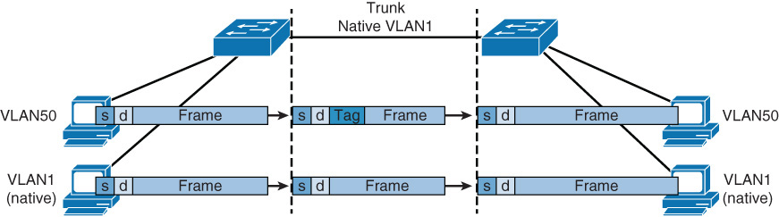
Native VLAN with IEEE 802.1Q
The 802.1Q standard specifies how the switch should handle untagged frames sent or received on an 802.1Q trunk port.
An 802.1Q trunk port is assigned a default PVID, which is associated with all untagged traffic on the port. All traffic with a null VLAN ID is assumed to belong to the port default PVID. A packet with a VLAN ID equal to the outgoing port default PVID is sent untagged. All other traffic is sent with a VLAN tag.
Proactively configuring both ends of an 802.1Q trunk link with a native VLAN distinct from all other VLANs is recommended.
Notes:
802.1Q trunks define a native VLAN for frames that are not tagged by default. Switches transmit any Layer 2 frames from a native VLAN on the trunk port untagged. The receiving switch forwards all untagged packets to its native VLAN. The native VLAN is the default VLAN configuration of the port. When the port is not trunking, the access VLAN configuration defines the native VLAN. In the case of Cisco switches, the default native VLAN is VLAN 1, and you can configure any other VLAN as the native VLAN.
It is important that the 802.1Q trunk port between two devices have the same native VLAN configuration on both sides of the link. If there is a native VLAN mismatch on an 802.1Q link, CDP (if used and functioning) issues a Native VLAN Mismatch error. On select versions of Cisco IOS Software, CDP might not be transmitted or will be automatically turned off if VLAN1 is disabled on the trunk. In addition, If there is a native VLAN mismatch on either side of an 802.1Q link, Layer 2 loops might occur because VLAN1 STP bridge protocol data units (BPDU) are sent to the IEEE STP MAC address (0180.c200.0000) untagged.

Slide 35
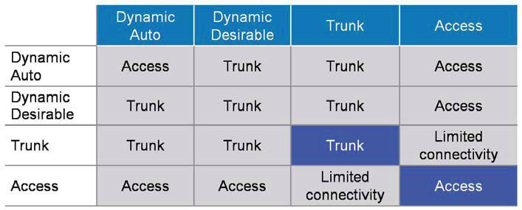
Dynamic Trunking Protocol (DTP)
Access - Puts the interface into permanent non-trunking mode and negotiates to convert the link into a non-trunk link. The interface becomes a non-trunk interface even if the neighboring interface does not agree to the change.
Trunk - Puts the interface into permanent trunking mode and negotiates to convert the link into a trunk link. The interface becomes a trunk interface even if the neighboring interface does not agree to the change.
Notes:
All recent Cisco Catalyst switches, except for the Catalyst 2900XL and 3500XL, use a Cisco proprietary point-to-point protocol called Dynamic Trunking Protocol (DTP) on trunk ports to negotiate the trunking state. DTP negotiates the operational mode of directly connected switch ports to a trunk port and selects an appropriate trunking protocol. Nego­tiating trunking is a recommended practice in multilayer switched networks because it avoids network issues resulting from trunking misconfigurations for initial configuration, but best practice is when the network is stable, change to trunk mode.
The default interface trunking mode is dynamic auto.

Slide 36
Dynamic Trunking Protocol (DTP)
Nonegotiate - Puts the interface into permanent trunking mode but prevents the interface from generating DTP frames. You must configure the neighboring interface manually as a trunk interface to establish a trunk link. Use this mode when connecting to a device that does not support DTP.
Dynamic desirable - Makes the interface actively attempt to convert the link to a trunk link. The interface becomes a trunk interface if the neighboring interface is set to trunk, desirable, or auto mode.
Dynamic auto - Makes the interface willing to convert the link to a trunk link. The interface becomes a trunk interface if the neighboring interface is set to trunk or desirable mode. This is the default mode for all Ethernet interfaces in Cisco IOS.

Slide 37
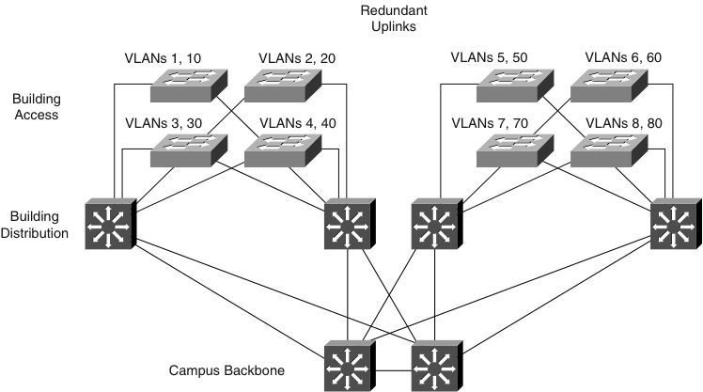
Design with VLAN Trunks
Trunks interconnect access layer switches.
Trunks connect access layer switches to distribution layer switches.
Layer 3 links interconnect core and distribution layer switches.
Access layer switches are configured in a spanning-tree, loop-free, V-shaped topology. If one distribution link fails, HSRP or VRRP provide an alternative default gateway.
Recommended: turn off DTP and manually prune VLANs on trunks.

Slide 38
Configuring an Interface for Trunking
Select the encapsulation type:
Switch(config-if)# switchport trunk encapsulation {isl | dot1q | negotiate}
Configure the interface as a Layer 2 trunk:
Switch(config-if)# switchport mode {dynamic {auto | desirable} | trunk}
Specify the native VLAN:
Switch(config-if)# switchport trunk native vlan vlan-id
Configure the allowable VLANs for this trunk:
Switch(config-if)# switchport trunk allowed vlan {add | except | all | remove} vlan-id[,vlan-id[,vlan-id[,...]]]
Switch(config)# interface FastEthernet 5/8
Switch(config-if)# switchport trunk encapsulation dot1q
Switch(config-if)# switchport mode trunk
Switch(config-if)# switchport nonegotiate optional
Switch(config-if)# switchport trunk native vlan 99
Switch(config-if)# switchport trunk allowed vlan 1-100
Switch(config-if)# no shutdown
Switch(config-if)# end
Notes:
With Cisco IOS Software Release 12.1(13)E and later, VLAN IDs might be in the range of 1 to 4094, except in the case of reserved VLANs. With Cisco IOS Release 12.1(11b)E or later, you can remove VLAN 1 from a trunk port. Even after removing VLAN 1 from a trunk, the trunk interface continues to send and receive management traffic. For example, CDP, VTP, Port Aggregation Protocol (PAgP), and DTP all use VLAN 1, regardless of the existence of VLAN 1 on the port.
Use the switchport mode trunk and switchport nonegotiate interface configuration commands to cause the interface to become a trunk but to not generate DTP frames.

Slide 39
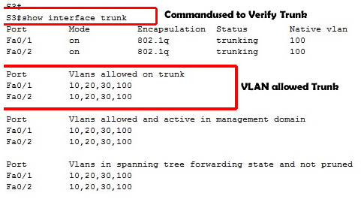
Verifying Trunk Configuration

Slide 40
Verifying Trunk Configuration
Switch# show running-config interface f5/8
Building configuration...
Current configuration:
!
interface FastEthernet5/8
switchport mode dynamic desirable
switchport trunk encapsulation dot1q
end
Switch# show interfaces f5/8 switchport
Name: Fa5/8
Switchport: Enabled
Administrative Mode: dynamic desirable
Operational Mode: trunk
Administrative Trunking Encapsulation: negotiate
Operational Trunking Encapsulation: dot1q
Negotiation of Trunking: Enabled
Access Mode VLAN: 1 (default)
Trunking Native Mode VLAN: 1 (default)
Trunking VLANs Enabled: ALL
Pruning VLANs Enabled: 2-1001
Switch# show interfaces f5/8 trunk
Port Mode Encapsulation Status Native vlan
Fa5/8 desirable n-802.1q trunking 1
Port Vlans allowed on trunk
Fa5/8 1-1005

Slide 41
Best Practices for VLANs and Trunking
One to three VLANs per access module and limit those VLANs to a couple of access switches and the distribution switches.
Avoid using VLAN 1 as the "blackhole" for all unused ports. Use a dedicated VLAN separate from VLAN 1 to assign all the unused ports.
Separate the voice VLANs, data VLANs, the management VLAN, the native VLAN, blackhole VLANs, and the default VLAN (VLAN 1).
Avoid VTP when using local VLANs; use manually allowed VLANs on trunks.
For trunk ports, turn off Dynamic Trunking Protocol (DTP) and configure trunking. Use IEEE 802.1Q rather than ISL because it has better support for QoS and is a standard protocol.
Manually configure access ports that are not specifically intended for a trunk link.

Slide 42
Best Practices for VLANs and Trunking
Prevent all data traffic from VLAN 1; only permit control protocols to run on VLAN 1 (DTP, VTP, STP BPDUs, PAgP, LACP, CDP, etc.).
Avoid using Telnet because of security risks; enable SSH support on management VLANs.
Links between distribution and core layers are usually Layer 3
To avoid spanning-tree problems, it is recommended not to link the two distribution switches as Layer 2 trunks
DTP is useful only if the status of the switch at the other end is uncertain or might change over time. Once a link is stable change both ends to trunk nonegotiate. This accelerates the convergence time at bootup
On trunk links, manually prune the VLANs that are not used
If trunking is not used on a port, use the macro command switchport host

Slide 43
Troubleshooting Trunk Links
Ensure that the Layer 2 interface mode configured on both ends of the link is valid. The trunk mode should be trunk or desirable for at least one side of the trunk.
Ensure that the trunk encapsulation type configured on both ends of the link is valid and compatible.
On IEEE 802.1Q trunks, make sure the native VLAN is the same on both ends of the trunk.
When using DTP, ensure that both ends of the link are in the same VTP domain.
Notes:
See previous slide for commands to verify trunk configuration.

Slide 44
Voice VLAN Overview
The voice VLAN feature places the phones into their own VLAN without any end-user intervention
The user simply plugs the phone into the switch, and the switch provides the phone with the necessary VLAN information
With the Voice VLAN feature, network administrators are able to gain all the advantages of physical infrastructure convergence, while maintaining separate logical topologies for voice and data terminals
Multiservice switches make the access port a multi-VLAN access port. The new parameter is called a voice or auxillary VLAN. Each port in the switch is associated with two VLANs
A native VLAN for data service that is identified by the PVID
A voice VLAN that is identified by the voice VLAN ID (VVID)
During the initial CDP exchange with the access switch, the IP phone is configured with a VVID
The IP phone is also supplied with a QoS configuration using CDP

Slide 45
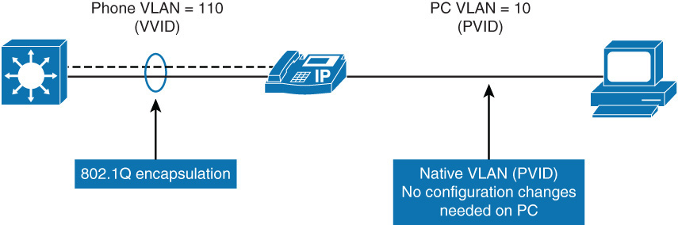
Voice VLAN overview
The multi-VLAN ports are not trunk ports, even though the hardware is set to the dot1Q trunk
The port is considered an access port that is able to carry one native VLAN and the voice VLAN
The switchport host command can be applied to a multi-VLAN access port on the access switch

Slide 46
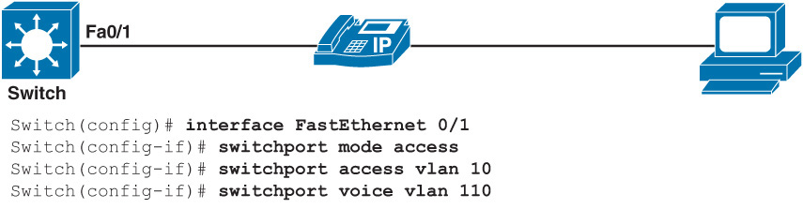
Voice VLAN configuration
When you run the show vlan command, both the voice and data VLAN are seen applied to the interface Fa0/1
Switch# show vlan
VLAN Name Status Ports
---- ---------------- -------- ----------------------
1 Default active Fa0/6, Fa0/7, Fa0/8, Fa0/9, Fa0/10
10 VLAN0010 active Fa0/1
110 VLAN0110 active Fa0/1
←--- output omitted ---→

Slide 47
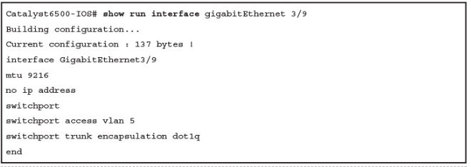
Questions
3. If the interface in above negotiates trunking, what would be the native VLAN?
a. VLAN 1
b. VLAN 5
c. VLAN 9216
d. No native VLAN if the port negotiated trunking

Slide 48
Questions
4. Which statements are true for the configuration of the interface in the above example?
a. The interface is a member of VLAN 5 if the interface does negotiate to a trunk.
b. The interface may negotiate to an ISL trunk with a native VLAN of 5.
c. The interface may negotiate to an 802.1Q trunk and operate with a native VLAN of 1.
d. The interface will not negotiate to a trunk port because it is configured in access VLAN 5.
e. If a host workstation is connected to the interface, it must be configured for trunking.

Slide 49
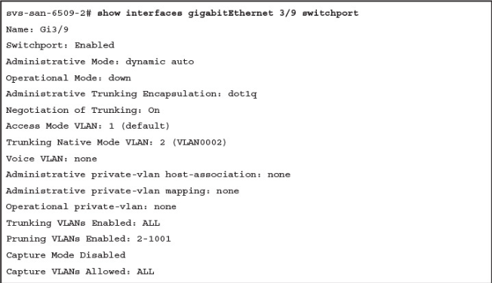
Questions
5. What is the trunk native VLAN based on the above?
a. VLAN 1
b. VLAN 2
c. VLAN 5
d. No Native VLAN if the port negotiated trunking

Slide 50
Questions
6. Based on above, what statement is true if the link partner (peer switch) is configured for the dynamic trunking mode?
a. The interface cannot negotiate to a trunk port because it is configured for dot1Q encapsulation.
b. The interface cannot negotiate to a trunk port because the native VLAN and access VLANs are mismatched.
c. The interface can negotiate to a trunk port if the peer is configured for the dynamic desirable trunking mode.
d. The interface can negotiate to a trunk port if access VLAN is the same on both sides.

Slide 51

VLAN Trunking Protocol

Slide 52
VTP Overview
VTP is a Layer 2 protocol that maintains VLAN configuration consistency by managing the additions, deletions, and name changes of VLANs across networks
Switches transmit VTP messages only on 802.1Q or ISL trunks.
VTP packets are sent to the destination MAC address 01-00-0C-CC-CC-CC
Cisco switches transmit VTP summary advertisements over the management VLAN (VLAN 1 by default) using a Layer 2 multicast frame every 5 minutes.
VTP domain is one switch or several interconnected switches sharing the same VTP environment but switch can be only in one VTP domain at any time.
By default, a Cisco Catalyst switch is in the no-management-domain state or <null> until it receives an advertisement for a domain over a trunk link or until you configure a management domain.
Configurations that are made on a single VTP server are propagated across trunk links to all of the connected switches in the network.
Configurations will be exchanged if VTP domain and VTP passwords match.
VTP is a Cisco proprietary protocol.

Slide 53
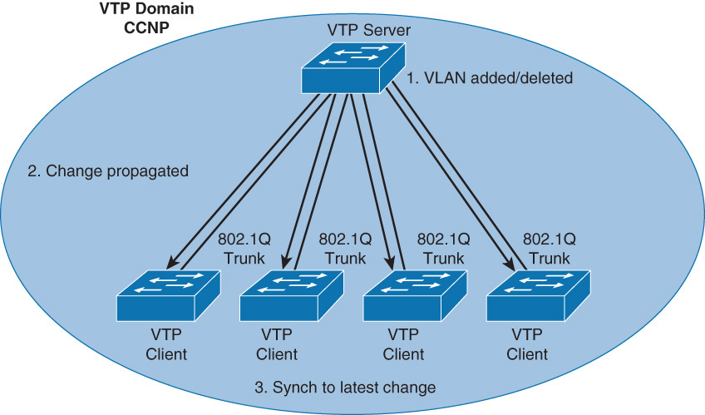
VTP Propagation
Configurations made to a single VTP server propagate across trunk links to all connected switches in the network in the following manner:
Step 1. An administrator adds a new VLAN definition
Step 2. VTP propagates the VLAN information to all switches in the VTP domain
Step 3. Each switch synchronizes its configuration to incorporate the new VLAN data

Slide 54
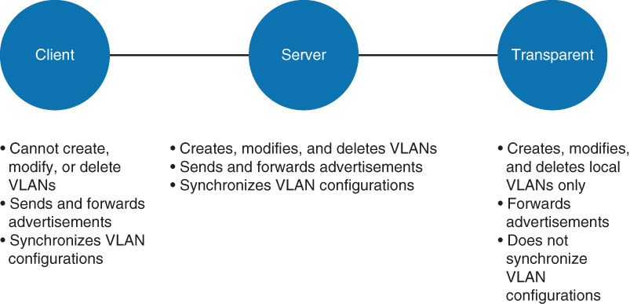
VTP Modes and Its Characteristics
Notes:
VTP server mode is the default.
Catalyst switches do not propagate VTP information out trunk interfaces until a management domain is specified or learned.
In VTP version 3, there is a concept of a primary server and a secondary server.

Slide 55
VTP Operation
By default, Cisco IOS VTP servers and clients save VLANs to the vlan.dat file in flash memory, causing them to retain the VLAN table and revision number.
The erase startup-config command does not affect the vlan.dat file on switches in VTP client and server modes.
Switches that are in VTP transparent mode display the VLAN and VTP configurations in the show running-config command output because this information is stored in the configuration text file.
If you perform erase startup-config on a VTP transparent switch you will delete its VLANs.

Slide 56
VTP Versions
Three VTP versions: V1, V2, V3.
Versions 1 and 2 are not interoperable (e.g., V2 supports token ring VLANs but V1 does not).
Unrecognized Type-Length-Value (TLV) configuration changes are propagated by V2 servers and clients and these unrecognized TLVs can be stored in NVRAM.
V1 transparent switches inspect VTP messages for the domain name and version and forward a message only if the version and domain name match. V2 transparent switches forward VTP messages in transparent mode without checking versions.
V2 performs VLAN consistency checks (VLAN names and values) only when you enter new information through the CLI or via SNMP. V2 does not perform checks when new information is obtained from a VTP message or when information is read from NVRAM. If the MD5 hash on a received VTP message is correct, V2 accepts the VTP message information.
Notes:
TLV optional information may be encoded as a type-length-value or TLV element inside the protocol. One of the advantages of using a TLV representation is that TLV sequences are easily searched using generalized parsing functions.
VTP version 3 is supported in Cisco CatOS Software versions 8.1 and above and all the latest Cisco IOS images. VTP version 3 differs from earlier VTP versions in that it does not directly handle VLANs. Instead, it is responsible for distributing a list of databases over an administrative domain. The following items are enhancements in VTP version 3:
Support for extended VLANs (1025 to 4094)
Support for the creation and advertising of Private VLANs
Improved server authentication
Enhancements to a mechanism for protection from the “wrong” database accidentally being inserted into a VTP domain
Interaction with VTP versions 1 and 2
Configurable on a per-port basis
Note: Check the config guide of a platform to find the VTP version supported. VTP version 3 has the same features as VTP versions 1 and 2 except for the addition of the modes of primary and secondary server and the concept of database consistency.
Note: VTP version 3 is still not common in the field and not the focus of the certification exam.

Slide 57
VTP Version 3
Extended VLAN support: VTP can propagate VLANs with numbers 1017 – 4094
Domain name is not automatically learned: VTPv2 with a factory default will change the domain name to the one received in a VTP message. VTPv3 forces manual configuration
Better security: VTP domain password is secure during transmission and in the switch’s database
Better database propagation: Only the primary server is allowed to update other devices, and only one server per VTP domain is allowed to have this role
Multiple Spanning Tree (MST) support: VTPv3 adds support for propagation of MST instances
Note VTPv3 is not compatible with VTPv1. VTPv3 is compatible with VTPv2 as long as you are not using it to propagate private or extended VLANs

Slide 58
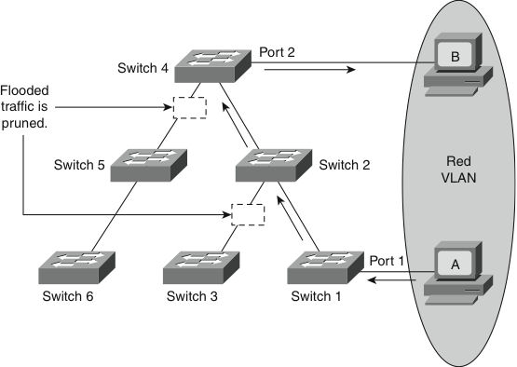
VTP Pruning
VTP pruning prevents flooded traffic from propagating to switches that do not have members in specific VLANs.
VTP pruning uses VLAN advertisements to determine when a trunk connection is flooding traffic needlessly. Switches 1 and 4 in the figure support ports statically configured in the Red VLAN.
The broadcast traffic from Station A is not forwarded to Switches 3, 5, and 6 because traffic for the Red VLAN has been pruned on the links indicated on Switches 2 and 4.

Slide 59
VTP Authentication
VTP domains can be secured by using the VTP password feature.
It is important to make sure that all the switches in the VTP domain have the same password and domain name; otherwise, a switch will not become a member of the VTP domain.
Cisco switches use the message digest 5 (MD5) algorithm to encode passwords in 16-byte words.
These passwords propagate inside VTP summary advertisements.
In VTP, passwords are case sensitive and can be 8 to 64 characters in length.
The use of VTP authentication is a recommended practice.

Slide 60
VTP Advertisements

Slide 61
VTP Message Types
Summary Advertisements
Subset Advertisements
Advertisement Requests

Slide 62
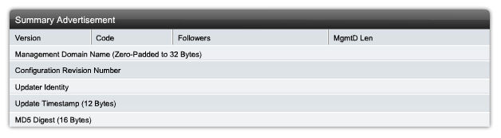
VTP Summary Advertisements
By default, Catalyst switches issue summary advertisements in 5-minute increments.
Summary advertisements inform adjacent switches of the current VTP domain name and the configuration revision number.
When the switch receives a summary advertisement packet, the switch compares the VTP domain name to its own VTP domain name.
If the name is different, the switch ignores the packet. If the name is the same, the switch then compares the configuration revision to its own revision.
If its own configuration revision is higher or equal, the packet is ignored. If it is lower, an advertisement request is sent.

Slide 63
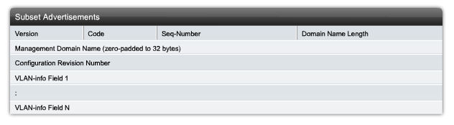
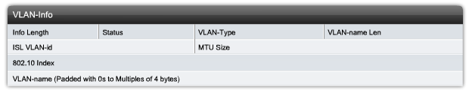
VTP Subset Advertisements
When you add, delete, or change a VLAN, the VTP server where the changes are made increments the configuration revision and issues a summary advertisement. One or several subset advertisements follow the summary advertisement.
A subset advertisement contains a list of VLAN information. If there are several VLANs, more than one subset advertisement can be required to advertise all the VLANs.

Slide 64
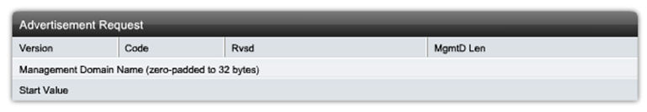
VTP Advertisement Requests
A switch issues a VTP advertisement request in these situations:
The switch has been reset.
The VTP domain name has been changed.
The switch has received a VTP summary advertisement with a higher configuration revision than its own.
Upon receipt of an advertisement request, a VTP device sends a summary advertisement.
One or more subset advertisements follow the summary advertisement.

Slide 65
Configuring VTP
Step 1. Enter global configuration mode:
Switch# configure terminal
Step 2. Configure the VTP mode as server:
Switch(config)# vtp mode server
Step 3. Configure the domain name:
Switch(config)# vtp domain domain_name
Step 4. (Optional.) Enable VTP version 2:
Switch(config)# vtp version 2
Step 5. (Optional.) Specify a VTP password:
Switch(config)# vtp password password_string
Step 6. (Optional.) Enable VTP pruning in the management domain:
Switch(config)# vtp pruning

Slide 66
VTP Configuration Example
This example creates a VTP server with domain name Modular_Form, password genus, and pruning enabled.
Switch# configure terminal
Switch(config)# vtp mode server
Setting device to VTP SERVER mode.
Switch(config)# vtp domain Modular_Form
Switch(config)# vtp password genus
Switch(config)# vtp pruning
Switch(config)# end

Slide 67
Verifying VTP Configuration (1)
The most useful command for verifying VTP configuration is the show vtp status command. The output displayed includes the VTP version, the VTP configuration revision number, the number of VLANs supported locally, the VTP operating mode, the VTP domain name, and the VTP pruning mode.
Switch# show vtp status
VTP Version : 2
Configuration Revision : 247
Maximum VLANs supported locally : 1005
Number of existing VLANs : 33
VTP Operating Mode : Server
VTP Domain Name : Modular_Form
VTP Pruning Mode : Enabled
VTP V2 Mode : Disabled
VTP Traps Generation : Disabled
MD5 digest : 0x45 0x52 0xB6 0xFD 0x63 0xC8 0x49 0x80
Configuration last modified by 0.0.0.0 at 8-12-99 15:04:4

Slide 68
Verifying VTP Configuration (2)
Use the show vtp counters command to display statistics about VTP operation. If there are any problems regarding the VTP operation, this command helps look for VTP message type updates.
Switch# show vtp counters
VTP statistics:
Summary advertisements received : 7
Subset advertisements received : 5
Request advertisements received : 0
Summary advertisements transmitted : 997
Subset advertisements transmitted : 13
Request advertisements transmitted : 3
Number of config revision errors : 0
Number of config digest errors : 0
Number of V1 summary errors : 0
VTP pruning statistics:
Trunk Join Transmitted Join Received Summary advts received from non-pruning-capable device
------ ---------------- ------------- -----------------
Fa5/8 43071 42766 5

Slide 69
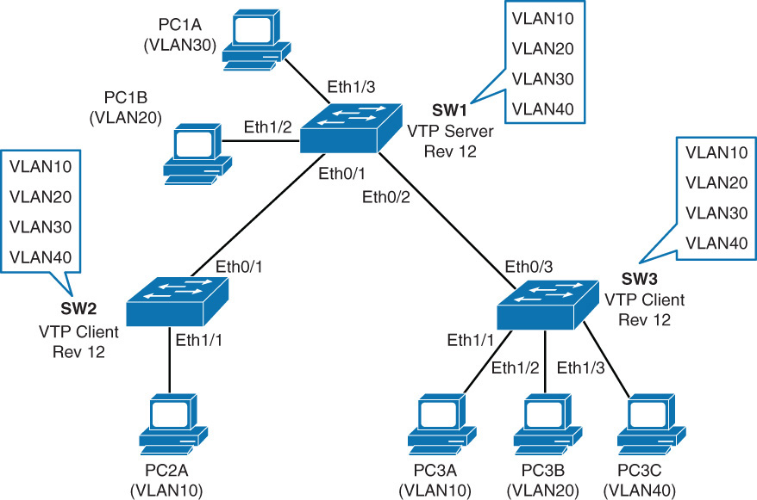
Problem- Overwriting VTP Configuration
This is a very common issue with VTP. It is important that when a new switch is added to a network that it does not inject spurious information into the domain.
Below is shown a network with the switches synced to a revision number of 12

Slide 70
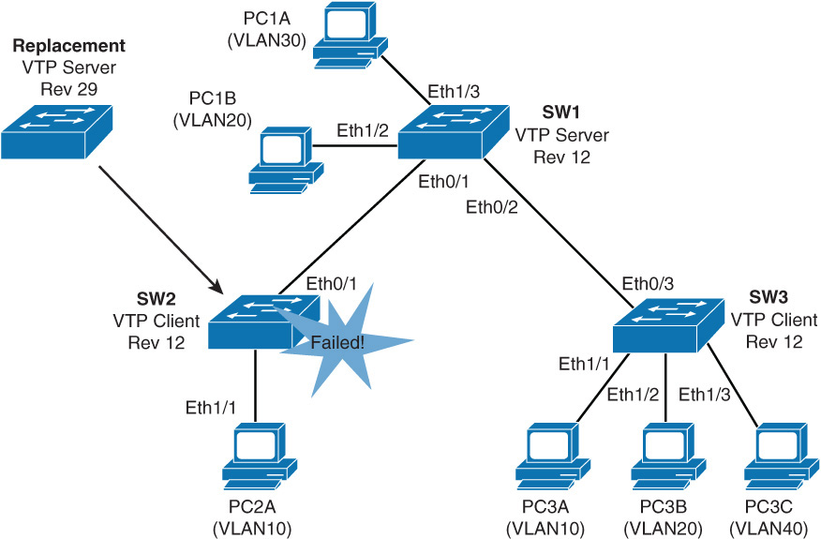
Problem- Overwriting VTP Configuration
Switch 2 fails and it is replaced with another switch, however the network administrator forgot to erase the configuration and VLAN database

Slide 71
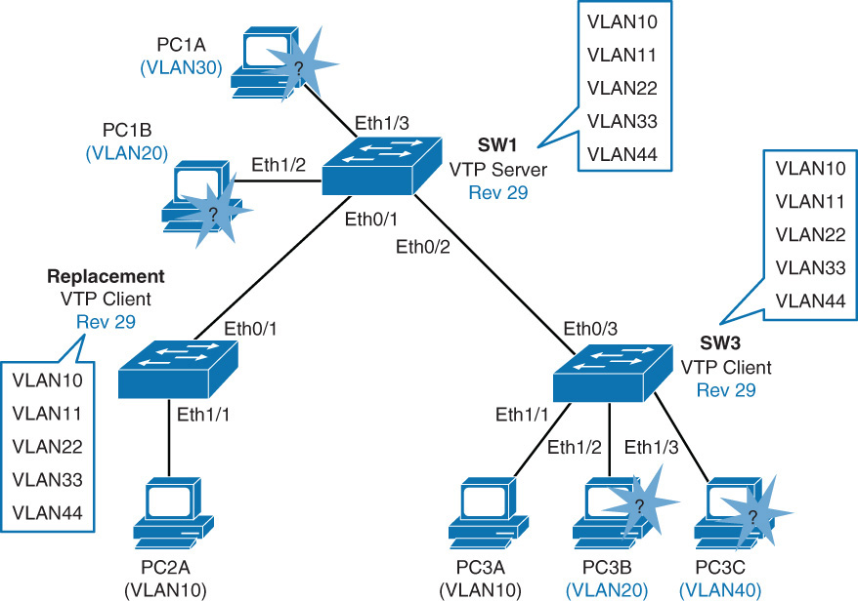
Problem- Overwriting VTP Configuration
The replacement switch has the same VTP domain name and a higher revision number of 29. SW1 and SW3 will sync and VLANs 20, 30, and 40 no longer exist
server

Slide 72
VTP – Some Key Points
Avoid, as much as possible, VLANs that span the entire network
The VTP revision number is stored in NVRAM and is not reset if you erase the switch configuration and reload it. To reset the VTP revision number to zero, use the following two options
Change the switch’s VTP domain to a nonexistent VTP domain, and then change the domain back to the original name
Change the switch’s VTP mode to transparent and then back to the previous VTP mode

Slide 73
Best Practices for VTP Implementation
VTP is often used in a new network to facilitate the implementation of new VLANs.
However, as the network grows larger, this benefit can turn into a liability.
If a VLAN is deleted by accident on one server, it is deleted throughout the network.
If a switch that already has a VLAN database defined is inserted into the network, it can hijack the VLAN database by deleting added VLANs.
Because of this, it is the recommended practice to configure all switches to transparent VTP mode and manually add VLANs as needed, especially in a larger campus network. VTP is better suited for small environments
Notes:
Best Practices for VTP implementation
VTP is often used in a new network to facilitate the implementation of new VLANs. However, as the network grows larger, this benefit can turn into a liability. If a VLAN is deleted by accident on one server, it is deleted throughout the network. If a switch that already has a VLAN database defined is inserted into the network, it can hijack the VLAN database by deleting added VLANs. Because of this, it is the recommended practice to configure all switches to transparent VTP mode and manually add VLANs as needed, especially in a larger campus network. VTP is better suited for small environments.

Slide 74
VTP Troubleshooting
Check that switches are interconnected by active trunk links.
Check that the trunking protocol matches on opposite ends of a trunk link.
Check VTP domain name (case-sensitive) and password.
Check the VTP mode of the switches.
Check the VTP versions of the switches.

Slide 75
Questions
7. How can you reset VTP revision number on a switch? (Choose two.)
a. Set the switch to transparent mode and then to server mode.
b. Set the switch to client mode and then to server mode.
c. Change the VTP domain name to a nonexistent VTP domain and then back to the original name.
d. Reload the switch.
8. Which statement about transparent VTP mode is true?
a. Creates, modifies, and deletes VLANs on all switches in VTP domain
b. Creates, modifies, and deletes local VLANs only
c. Does not forward advertisements to other switches in VTP domain
d. Synchronizes VLAN configurations from other switches in VTP domain

Slide 76

Implementing EtherChannel in a Switched Network

Slide 77
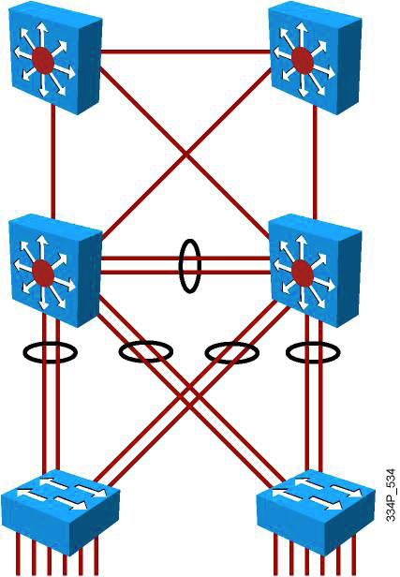
The Need for EtherChannel

Slide 78
EtherChannel Overview
EtherChannel is a technology that was originally developed by Cisco as a LAN switch-to-switch technique of grouping several Fast or Gigabit Ethernet ports into one logical channel.
This technology has many benefits:
It relies on the existing switch ports. There is no need to upgrade the switch-to-switch link to a faster and more expensive connection.
Most of the configuration tasks can be done on the EtherChannel interface instead of on each individual port, thus ensuring configuration consistency throughout the switch-to-switch links.
Load balancing is possible between the links that are part of the same EtherChannel. Depending on the hardware platform, you can implement one or several methods, such as source-MAC to destination-MAC or source-IP to destination-IP load balancing across the physical links.
Notes:
Note Using new technologies like VSS (Virtual Switching System) and vPC (Virtual Port Channel), a port channel can be created across two aggregation switches from the same access layer to provide better redundancy.

Slide 79
EtherChannel Technology
Up to 8 physical links can be bundled into a single logical EtherChannel link.
Usually EtherChannel is used for trunk links.
Configuration applied to port channel interface affects all physical interfaces assigned to the port channel.
Load balancing takes place between the physical links in an EtherChannel.
EtherChannels can be L2 or L3 interfaces.

Slide 80
EtherChannel Mode Interactions
EtherChannel can be established using one of the following three mechanisms:
LACP: IEEE’s negotiation protocol
PAgP: Cisco’s negotiation protocol
Static persistence: No negotiation protocol

Slide 81
Link Aggregation Control Protocol (LACP)
Link Aggregation Control Protocol (LACP) is part of an IEEE specification (802.3ad) that allows several physical ports to be bundled together to form a single logical channel. LACP allows a switch to negotiate an automatic bundle by sending LACP packets to the peer.
It ensures that when EtherChannel is created, all ports have the same type of configuration speed, duplex setting, and VLAN information. Any port modification after the creation of the channel will also change all the other channel ports.
The switch with the lowest system priority is allowed to make decisions about what ports actively participate in EtherChannel.

Slide 82
Link Aggregation Control Protocol (LACP)
Ports become active according to their port priority.
A lower number means higher priority.
Commonly up to 16 links can be assigned to an EtherChannel, but only 8 can be active at a time.
Nonactive links are placed into a standby state and are enabled if one of the active links goes down.
The maximum number of active links in an EtherChannel varies between switches.

Slide 83
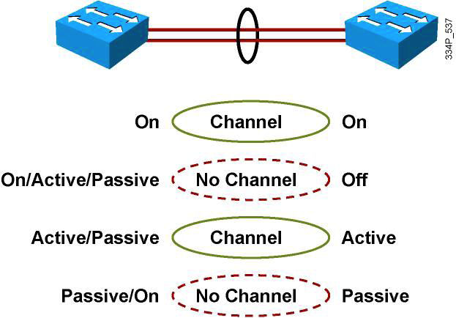
LACP Modes of Operation
Mode | Purpose
Passive | Places a port in a passive negotiating state. In this state, the port responds to the LACP packets that it receives but does not initiate LACP packet negotiation (default).
Active | Places a port in an active negotiating state. In this state, the port initiates negotiations with other ports by sending LACP packets.
On | Forces the interface to the channel without PAgP or LACP.
Notes:
LACP provides the same negotiation benefits as PAgP. LACP helps create the EtherChannel link by detecting each side’s configuration and making sure they are compatible so that the EtherChannel link can be enabled when needed. Just like with PAgP, modes must be compatible on both sides for the EtherChannel link to form, as shown in the figure; the figure displays the different options setting on both sides of the links and its results if EtherChannel is created. The On form creates an EtherChannel configuration unconditionally.
The following are some additional parameters that you can use when configuring LACP:
System priority: Each switch running LACP must have a system priority. The system priority can be specified automatically or through the command-line interface (CLI). The switch uses the MAC address and the system priority to form the system ID.
Port priority: Each port in the switch must have a port priority. The port priority can be specified automatically or through the CLI. The port priority and the port number form the port identifier. The switch uses the port priority to decide which ports to put in standby mode when a hardware limitation prevents all compatible ports from aggregating.
Administrative key: Each port in the switch must have an administrative key value, which can be specified automatically or through the CLI. The administrative key defines the capability of a port to aggregate with other ports, determined by these factors:
The port physical characteristics, such as data rate, duplex capability, and point-to-point or shared medium
The configuration constraints that you establish
Note: All the preceding options of LACP are optional to configure. Usually, defaults are the best to use. To configure any of these options, refer to your configuration guide.
When enabled, LACP attempts to configure the maximum number of compatible ports in a channel. In some instances, LACP cannot aggregate all the compatible ports. For example, the remote system might have more restrictive hardware limitations. When this occurs, all the ports that cannot be actively included in the channel are put in a hot standby state and used only if one of the channeled ports fails.

Slide 84
LACP Modes of Operation
The following are some additional parameters that you can use when configuring LACP:
System priority
Each switch running LACP must have a system priority. The system priority can be specified automatically or through the CLI. The switch uses the MAC address and the system priority to form the system ID.
Port priority
Each port in the switch must have a port priority. The port priority can be specified automatically or through the CLI.
Administrative key
Each port in the switch must have an administrative key value, which can be specified automatically or through the CLI. The administrative key defines the capability of a port to aggregate with other ports, determined by these factors: the port’s physical characteristics, such as data rate, duplex capability, and point-to-point or shared medium.
Notes:
The port priority and the port number form the port identifier. The switch uses the port priority to decide which ports to put in standby mode when a hardware limitation prevents all compatible ports from aggregating.

Slide 85
Port Aggregation Protocol (PAgP)
Port Aggregation Protocol (PAgP) provides the same negotiation benefits as LACP.
PAgP is a Cisco proprietary protocol, and it will work only on Cisco devices.
PAgP packets are exchanged between switches over EtherChannel-capable ports.
Neighbors are identified and capabilities are learned and compared with local switch capabilities.
Ports that have the same capabilities are bundled together into an EtherChannel.
PAgP forms an EtherChannel only on ports that are configured for identical VLANs or trunking.
PAgP will automatically modify parameters of the EtherChannel if one of the ports in the bundle is modified.
PAgP and LACP are not compatible.
Notes:
For example, if configured speed, duplex, or VLAN of a port in a bundle is changed, PAgP reconfigures that parameter for all ports in the bundle.

Slide 86

PAgP Modes of Operation
Mode | Purpose
Auto | Places an interface in a passive negotiating state in which the interface responds to the PAgP packets that it receives but does not initiate PAgP negotiation (default).
Desirable | Places an interface in an active negotiating state in which the interface initiates negotiations with other interfaces by sending PAgP packets. Interfaces configured in the “on” mode do not exchange PAgP packets.
On | Forces the interface to channel without PAgP.
Non-silent | If a switch is connected to a partner that is PAgP-capable, configure the switch interface for non-silent operation. The non-silent keyword is always used with the auto or desirable mode. If you do not specify non-silent with the auto or desirable mode, silent is assumed. The silent setting is for connections to file servers or packet analyzers; this setting enables PAgP to operate, to attach the interface to a channel group, and to use the interface for transmission.
Notes:
PAgP manages the EtherChannel. PAgP packets are sent every 30 seconds. PAgP checks for configuration consistency and manages link additions and failures between two switches.
PAgP helps create the EtherChannel link by detecting each side’s configuration and making sure they are compatible.
Caution: PAgP modes are similar to the DTP modes, but they have different functions.
Referencing the table,
If you configure an interface to be in Auto mode, it will be placed in a passive state, waiting for the other side to initiate the EtherChannel negotiation. If the other side is also set to Auto, the negotiation never starts and the EtherChannel does not form. If you “unconfigure” all modes by using the no command or if no mode is configured, the interface is placed in an Off mode and EtherChannel is disabled.
Notice the “On” form. This command manually places the interface in EtherChannel without any negotiation. It works only if the other side is also set to On. If the other side is set to negotiate parameters through PAgP, no EtherChannel will form because the On side will not negotiate.

Slide 87
Statically Bundle Links
Negotiation with either LACP or PAgP introduces overhead and delay in initialization.
As an alternative, you can statically bundle links into an EtherChannel.
This method introduces no delays but can cause problems if not properly configured on both ends.

Slide 88
Layer 2 EtherChannel Configuration Guidelines
Before implementing EtherChannel in a network, plan the following steps necessary to make it successful:
The first step is to identify the ports that you will use for the EtherChannel on both switches. (and shut down)
Each interface should have the appropriate protocol identified (PAgP or LACP), have a channel group number to associate all the given interfaces with a port group, and be configured whether negotiation should occur. (and no shut)
After the connections are established, make sure that both sides of the EtherChannel have formed and are providing aggregated bandwidth.

Slide 89
Layer 2 EtherChannel Configuration Guidelines
Follow these guidelines and restrictions when configuring EtherChannel interfaces:
EtherChannel support
All Ethernet interfaces on all modules support EtherChannel, with no requirement that interfaces be physically contiguous or on the same module. (maximum of eight interfaces)
Switched port analyzer (SPAN) and EtherChannel: An EtherChannel does not form if one of the interfaces is a SPAN destination port.
Speed and duplex
Configure all interfaces in an EtherChannel to operate at the same speed and in the same duplex mode.
VLAN match
All interfaces in the EtherChannel bundle must be assigned to the same VLAN or be configured as a trunk.

Slide 90
Layer 2 EtherChannel Configuration Guidelines
Range of VLANs
An EtherChannel supports the same allowed range of VLANs on all the interfaces in a trunking Layer 2 EtherChannel.
STP path cost
Interfaces with different STP port path costs can form an EtherChannel as long as they are compatibly configured.
Setting different STP port path costs does not, by itself, make interfaces incompatible for the formation of an EtherChannel.
Port channel versus interface configuration
After you configure an EtherChannel, any configuration that you apply to the port channel interface affects the EtherChannel.
Any configuration that you apply to the physical interfaces affects only the specific interface that you configured.

Slide 91
Configuring EtherChannel
Step 1. Specify the interfaces that will compose the EtherChannel group. Using the range commands enables you to select several interfaces and configure them all together.
A good practice is to start by shutting down these interfaces, so that incomplete configuration will not start to create activity on the link:
Switch(config)# interface range interface_type [interface_range]
Step 2. Specify the channeling protocol to be used. This command is not applicable to all Catalyst platforms. You can also specify the channeling protocol at Step 3:
Switch(config-if-range)# channel-protocol {pagp | lacp}
Notes:
The first step is to identify the ports for the EtherChannel on both switches. This helps identify any issues with previous configurations on the ports and ensures that the proper connections are available.
The network designer should already have decided whether this is going to be a Layer 3 or a Layer 2 connection. If it is a Layer 2 connection, each interface should have the appropriate protocol identified (PAgP or LACP), have a channel group number to associate all the given interfaces to a port group, and know whether negotiations should occur.
If this is a Layer 3 connection, a new virtual interface is created. This port-channel interface is then given an IP address. Each of the physical interfaces is then made into an EtherChannel by specifying the same channel group number as the port-channel interface number.
When the connections are established, a couple of commands can ensure that both sides of the EtherChannel have formed and are providing aggregated bandwidth.

Slide 92
Configuring EtherChannel
Step 3. Create the port-channel interface, if necessary, and assign the specified interfaces to it:
Switch(config-if-range)# channel-group number mode {active | on | {auto [non-silent]} | {desirable [non-silent]} | passive
Step 4. Specify the port-channel interface. When in the interface configuration mode, you can configure additional parameters. The physical interfaces will inherit these parameters. When this configuration is complete, you can reenable the physical ports in the EtherChannel bundle:
Switch(config)# interface port-channel number
Switch(config-if)# interface parameters

Slide 93
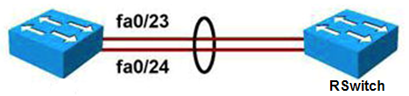
Example: EtherChannel Configuration
Switch(config)# interface range fa0/23-24
Switch(config-if)# channel-group 2 mode active
Switch(config)# interface port-channel 2
Switch(config-if)# switchport mode trunk
Switch(config-if)# switchport trunk native VLAN 99
Switch(config-if)# switchport trunk allowed VLAN 2,3,99
Remote Switch configuration
RSwitch(config)# interface fastethernet 0/23
RSwitch(config-if)# channel-group 5 mode on
RSwitch(config)# interface fastethernet 0/24
RSwitch(config-if)# channel-group 5 mode on
RSwitch(config)# interface port-channel 5
RSwitch(config-if)# switchport mode trunk
RSwitch(config-if)# switchport trunk native VLAN 99
Notes:
This example shows a Layer 2 EtherChannel bundle between two switches using LACP. Each switch shows two ports that are left to their default configuration. The switch on the left created EtherChannel 2, and the switch on the right created EtherChannel 5. These numbers are locally significant and do not need to match the neighbor configuration. The actual configuration of the link is then conducted on the EtherChannel interface. The link is configured to be unconditionally in 802.1q trunk mode, and some VLANs are pruned.
Speed and duplex: Configure all interfaces in an EtherChannel to operate at the same speed and in the same duplex mode.
VLAN match: All interfaces in the EtherChannel bundle must be assigned to the same VLAN or be configured as a trunk. Also make sure that all the interfaces are part of the same native VLANs on both switches.
Range of VLANs: An EtherChannel supports the same allowed range of VLANs on all the interfaces in a trunking Layer 2 EtherChannel.
Keep in mind that the EtherChannel interface configuration must be compatible with the underlying physical ports configuration. In the example, initially there is no specific configuration on each individual port for trunking, which implies that the default dynamic auto mode is applied. In this mode, ports detect whether the other side is a trunk and dynamically changes to trunk mode if needed. This mode is compatible with the trunk mode configured on the EtherChannel interface. The physical ports inherit the EtherChannel configuration and change to trunk mode.

Slide 94
Verifying EtherChannel (1)
You can use several commands to verify an EtherChannel configuration. On any physical interface member of an EtherChannel bundle, the show interfaces interface_id etherchannel command provides information on the role of the interface in the EtherChannel.
Interface FastEthernet 0/24 below is part of EtherChannel bundle 1.
The protocol for this EtherChannel is LACP.
Switch# show interfaces fa0/24 etherchannel
Port state = Up Sngl-port-Bndl Mstr Not-in-Bndl
Channel group = 1 Mode = Active Gcchange = -
Port-channel = null GC = - Pseudo port-channel = Po1
Port index = 0 Load = 0x00 Protocol = LACP

Slide 95
Verifying EtherChannel (2)
The show etherchannel number port-channel command can be used to display information about a specific port-channel.
Below Port-channel 1 consists of two physical ports, Fa0/23 and Fa0/24.
It uses LACP in active mode.
It is properly connected to another switch with a compatible configuration.This is why the port-channel is said to be in use.
Switch# show etherchannel 1 port-channel
Port-channels in the group:
---------------------------
Port-channel: Po1 (Primary Aggregator)
Age of the Port-channel = 195d:03h:10m:44s
Logical slot/port = 0/1 Number of ports = 2
Port state = Port-channel Ag-Inuse
Protocol = LACP
Ports in the Port-channel:
Index Load Port EC state No of bits
------+------+--------+--------------+-----------
0 55 fa0/23 Active 4
1 45 fa0/24 Active 4

Slide 96
Verifying EtherChannel (3)
When several port-channel interfaces are configured on the same device, the show etherchannel summary command is useful for displaying one-line information per port-channel.
As shown below; the switch has three EtherChannels configured: Groups 2 and 7 use LACP and Group 9 uses PAgP. Each EtherChannel has the member interfaces listed. All three groups are Layer 2 EtherChannels and are all in use (SU next to the port-channel number).
Switch# show etherchannel summary
Flags: D - down P - bundled in port-channel
I - stand-alone s - suspended
H - Hot-standby (LACP only)
R - Layer3 S - Layer2
U - in use f - failed to allocate aggregator
M - not in use, minimum links not met
u - unsuitable for bundling
w - waiting to be aggregated
d - default port
Number of channel-groups in use: 2
Number of aggregators: 2
Group Port-channel Protocol Ports
------+-------------+-----------+--------------------------------------------
2 Po2(SU) LACP g0/49(P) g0/50(P) g0/51(P) g0/52(P)
7 Po7(SU) LACP g0/47(P) g0/48(P)
9 Po9(SU) PAgP g0/8(P) g0/9(P)

Slide 97
Verifying EtherChannel (4)
The show running-config interface interface_id command displays sections of your configuration relevant to EtherChannel. The interface argument can be physical or logical.
Switch# show running-config interface g0/48
Building configuration...
Current configuration : 154 bytes
interface GigabitEthernet0/48
switchport access vlan 41
switchport trunk encapsulation dot1q
switchport mode trunk
channel-group 7 mode active
Switch# show running-config interface port-channel 7
Building configuration...
Current configuration : 92 bytes
interface Port-channel7
switchport trunk encapsulation dot1q
switchport mode trunk

Slide 98
EtherChannel Load Balancing
EtherChannel load balances traffic across links in the bundle. However, traffic is not necessarily distributed evenly among all links
Frames are forwarded based on results of a hashing algorithm
The hash algorithm calculates a binary pattern that selects a link within the Etherchannel bundle to forward the frame
Port-channel load-balance | Hash Input | Hash Operation | Switch Model
src-ip | Source IP address | bits | All models
dst-ip | Destination IP address | bits | All models
src-dst-ip | Source and destination IP address | XOR | All models
src-mac | Source MAC address | bits | All models
dst-mac | Destination MAC address | bits | All models
src-dst-mac | Source and destination MAC | XOR | All models
src-port | Source port number | bits | 6500, 4500
dst-port | Destination port number | bits | 6500, 4500
src-dst-port | Source and destination port | XOR | 6500, 4500

Slide 99
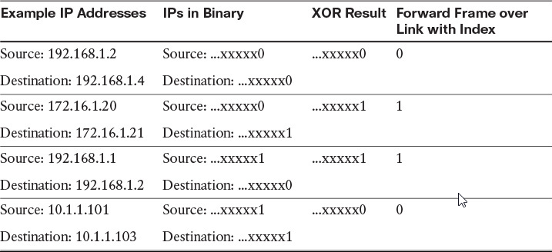
XOR on a two-link bundle using source and destination addresses

Slide 100
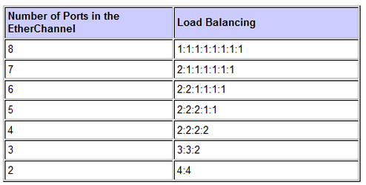
EtherChannel Load Balancing
The hash function gives a number between 0 and 7, and the following table shows how the 8 numbers are distributed among the 2 to 8 physical ports.
In the hypothesis of real random hash algorithm, 2, 4 or 8 ports configurations lead to fair load-balancing, whereas other configurations lead to unfair load-balancing.
Notes:
When the EtherChannel becomes one entity, the traffic is load balanced across multiple links. This subsection describes the configuration of load balancing among the ports included in an EtherChannel. Load balancing traffic across port members of the same EtherChannel is a key element in an EtherChannel configuration. As shown in the figure, two workstations communicate with a router through a switch. The link between the router and the switch is an EtherChannel link relying on two physical ports. Suppose that the majority of the traffic is going from the PCs toward the router. How should the traffic be load balanced across the two physical links? If load balancing is based on the destination IP address, most traffic will go through the same physical link. Because the router has only one single IP address for its bundled interface, this IP address will be associated to a first physical port, and all traffic destined to it will go through a single physical link. This renders the load-balancing mechanism inefficient. On the other hand, if load balancing is based on the source MAC address, the traffic might be far better balanced across both physical links because each PC has its MAC address seen on the switch.
As a rule, use the load-balancing option that provides the greatest variety in your configuration. For example, if the traffic on a channel is going to only a single MAC address, using the destination-MAC address always chooses the same link in the channel; using source addresses might result in better load balancing.
Note: EtherChannel balances traffic load across the links in a channel. The default and the load balancing methods available can vary among the Cisco switch families. The 2960, 3560, 3750 default to src-mac, whereas the 4550 and 6500 families default to src-dst-ip; this is the recommended option for Layer 3 switches.
Load balancing is applied globally for all EtherChannel bundles in the switch. To config­ure EtherChannel load balancing, use the port-channel load-balance command. Load balancing can be based on these variables. The load-balancing keywords are as follows:
src-mac: Source MAC addresses
dst-mac: Destination MAC addresses
src-dst-mac: Source and destination MAC addresses
src-ip: Source IP addresses
dst-ip: Destination IP addresses
src-dst-ip: Source and destination IP addresses (default)
src-port: Source TCP/User Datagram Protocol (UDP) port
dst-port: Destination TCP/UDP port
src-dst-port: Source and destination TCP/UDP port
Each mode is self-explanatory. For example, with source-MAC address forwarding, when packets are forwarded to an EtherChannel, they are distributed across the ports in the channel based on the source -MAC address of the incoming packet. Therefore, to provide load balancing, packets from different hosts use different ports in the channel, but packets from the same host use the same port in the channel. (And the MAC address learned by the switch does not change.)
With destination-MAC address forwarding, when packets are forwarded to an EtherChan­nel, they are distributed across the ports in the channel based on the destination-MAC ad­dress of the frame. Therefore, packets to the same destination are forwarded over the same port, and packets to a different destination are sent on a different port in the channel. You configure the load balancing and forwarding method by using the port-channel load-balance global configuration command.

Slide 101
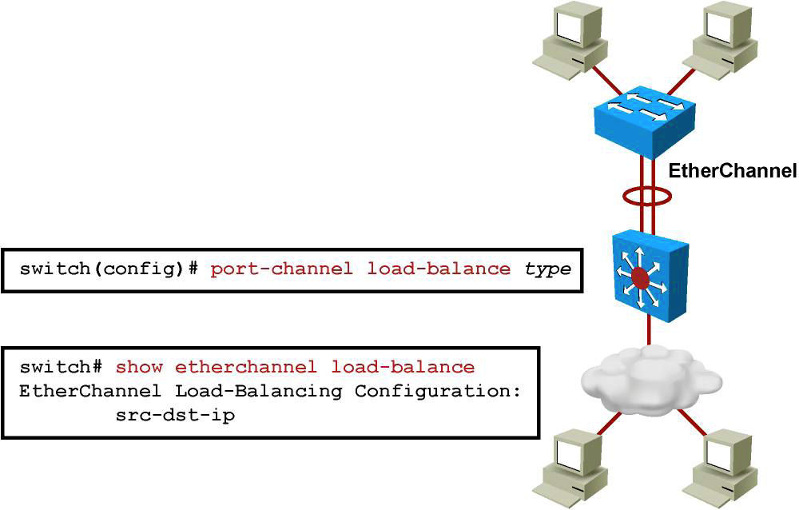
EtherChannel Load Balancing

Slide 102
Questions
9. Which of the following EtherChannel modes does not send or receive any negotiation frames?
a. Passive
b. Active
c. On
d. Desirable auto
10. Which of the following solutions are provided by EtherChannel? (Choose two.)
a. Provide redundancy
b. Help to overcome bandwidth limitation
c. Because of EtherChannel, can transmit more than one VLAN over the links between switches
d. Can limit the broadcast to the local switches

Slide 103
Chapter 3 Summary
Implementing VLANs and trunks in campus switched architecture
Understanding the concept of VTP and its limitation and configurations
Implementing and configuring EtherChannel

Slide 104
Chapter 3 Labs
CCNPv7.1 SWITCH Lab3.1 VLAN TRUNK VTP
CCNPv7.1 SWITCH Lab3.2 ETHERCHANNEL

Slide 105


